Slide 1
Chapter 10 – Excretion

Slide 2
10.1 Excretion in Mammals
You should be able to
discuss the importance of excretion in animals; and
give examples of excretory products and state the means by which they are eliminated.

Slide 3
10.1 Excretion in Mammals
What is excretion?
Excretion is the removal of metabolic waste and excess metabolites from the body
Excretion is different from egestion, which is the removal of undigested waste from the alimentary canal, which is different from metabolic waste.
Unicellular organisms can remove waste by diffusion across their cell membranes but complex organisms like animals require excretory organs.
The main excretory organs in humans are the skin, lungs and kidneys.

Slide 4
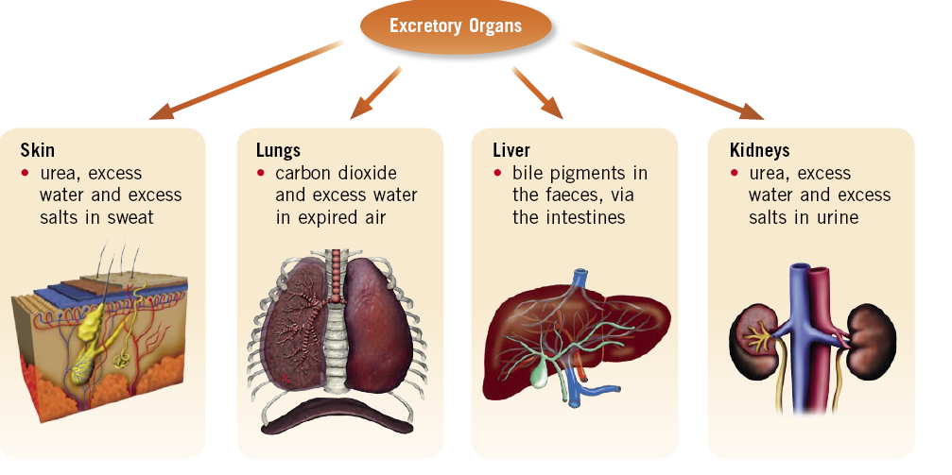
10.1 Excretion in Mammals
Excretory organs and their products

Slide 5
10.1 Excretion in Mammals
Excretory Products
Carbon dioxide is produced as a waste product of respiration; high levels of it lowers pH level of blood, resulting in adverse effect on the chemical reactions in cells.
Urea is produced by the liver as a result of deamination; its removal is carried out by the kidneys.
Bile pigments comes from the breakdown of haemoglobin; the liver excretes bile containing bile pigments into the gut and the pigments will be removed as part of the faeces.
Excess water and salts

Slide 6
10.2 The Kidney
You should be able to:
outline the function of kidney tubules in urine formation, with reference to ultrafiltration and selective reabsorption.

Slide 7
10.2 The Kidney
The Urinary System in Mammals
It consists of two kidneys (each found on each side of the vertebral column), a pair of ureters, a bladder and the urethra.
In humans, the kidneys are embedded in a thick cushion of fat, slightly above waistline, for protection.
The left kidney is slightly higher than the right kidney.

Slide 8
10.2 The Kidney
The Urinary System in Mammals
Kidneys receive blood from renal artery and return filtered blood to the circulation through the renal vein.
Waste and water leave the kidney via the ureter, and is stored in the bladder as urine.
As they accumulate, sense receptors in the bladdar are stimulated. Signals are sent to the brain to give the sensation of an urge to urinate.
Urine is released from the bladdar through the urethra when the sphincter muscle is relaxed.

Slide 9
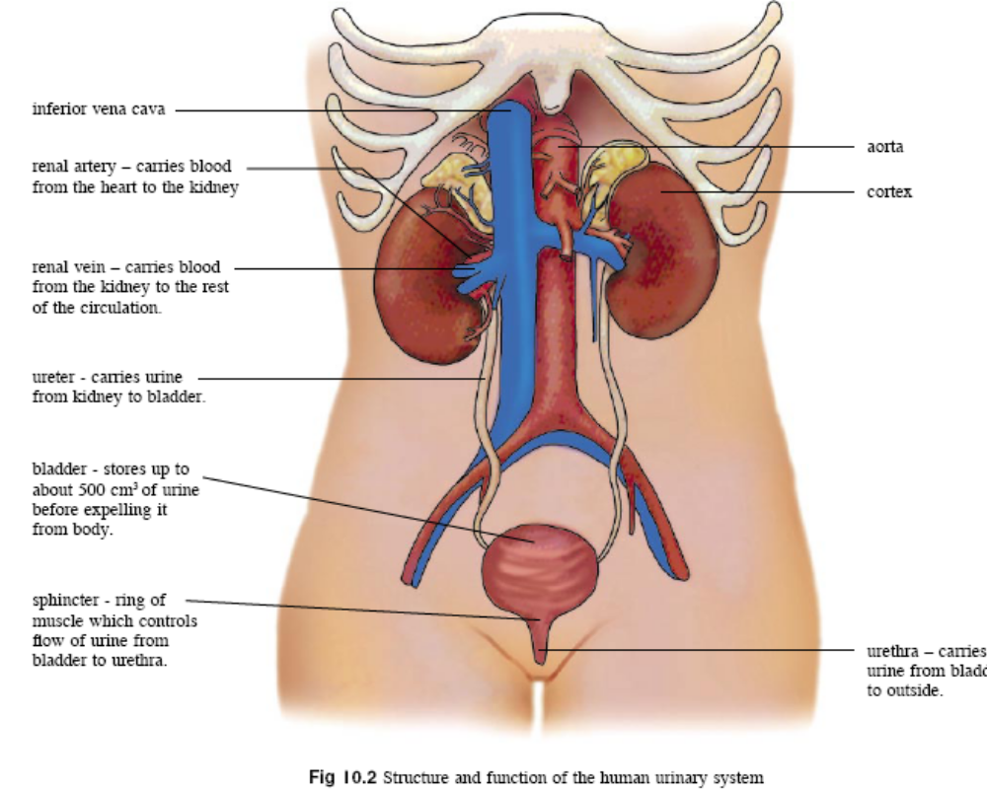
10.2 The Kidney

Slide 10
10.2 The Kidney
Structure of kidney
Each kidney has a solid outer cortex and an inner medulla.
The functional unit of a kidney is the nephron.
The nephron is responsible for carrying out waste removal and osmoregulation.

Slide 11
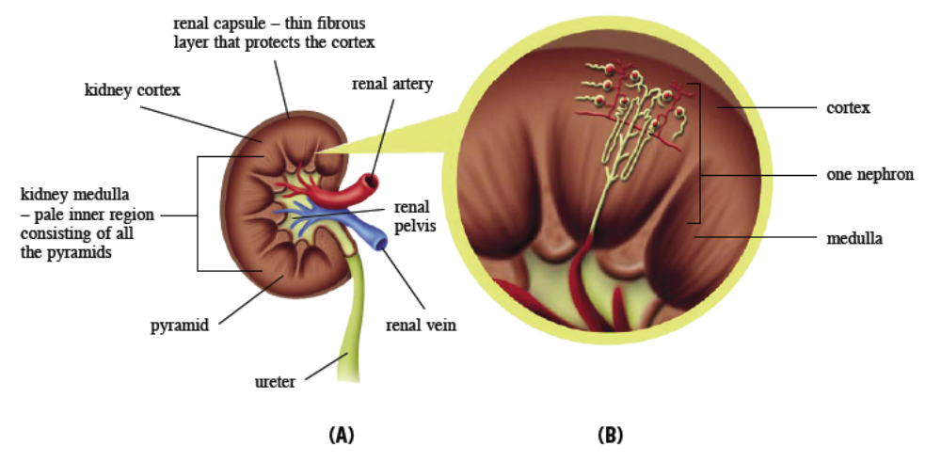
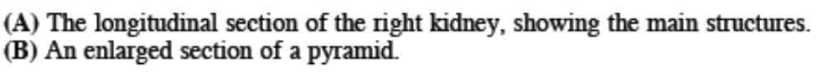
10.2 The Kidney

Slide 12
10.2 The Kidney
Parts of the nephron
A nephron consists of two main parts – the renal corpuscle and the renal tubule
Renal corpuscle consists of
  Glomerulus
  Network of blood capillaries surrounding renal tubule
Renal tubule consists of
  Proximal (first) convoluted tubule
  Loop of Henle
  Distal (Second) convoluted tubule
Urine from several distal convoluted tubules are drained into a common collecting duct.

Slide 13
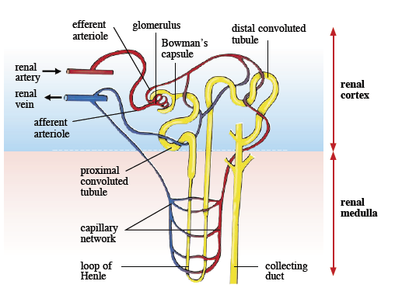

10.2 The Kidney

Slide 14
10.2 The Kidney
Urine Formation
Urine is produced by two main processes within the nephron:
Ultrafiltration (occurs at the glomerulus)
  Filters out all small molecules from the blood
Selective reabsorption (occurs at the kidney tubules)
  Reabsorbs the useful molecules from the kidney tubules back into the blood

Slide 15
10.2 The Kidney
Ultrafiltration
Afferent arteriole branches into glomerulus
Walls of glomerular capillaries have pores to allow small molecules (water, urea, glucose, amino acids) to be forced out into the Bowman’s capsule.
The difference in diameter of the afferent and efferent arteriole generates a high hydrostatic pressure that provides the force for the molecules to be forced out of the glomerulus.
Large molecules such as plasma proteins and red blood cells are retained in the blood.

Slide 16
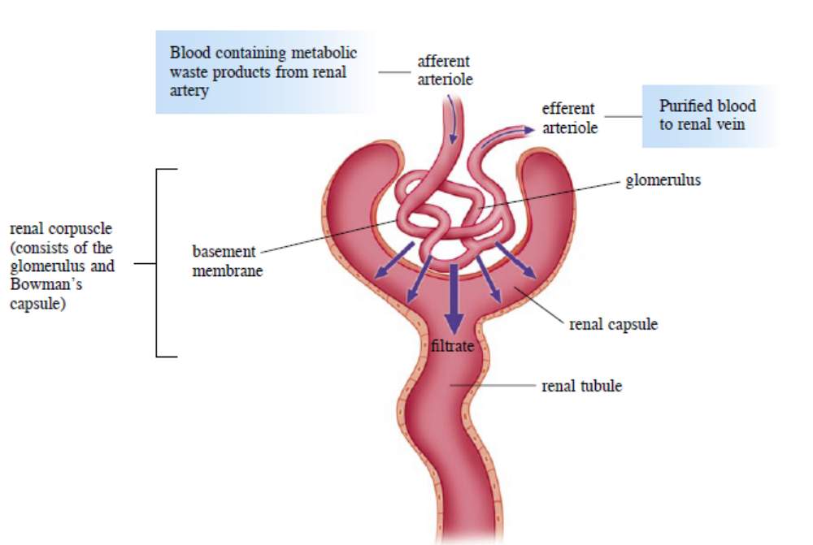

10.2 The Kidney

Slide 17
10.2 The Kidney
Selective Reabsorption
The kidney reabsorbs useful substances from the glomerular filtrate into the blood at the proximal (first) convoluted tubule. (>80% of filtrate absorbed)
All glucose, amino acids and some salts diffuse into the proximal convoluted tubule.
They are actively transported into the interstitial fluid in between the cells and the blood capillary.
As the filtrate becomes more dilute, water also leaves the tubule by osmosis.

Slide 18
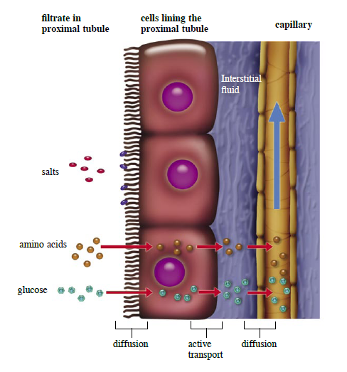
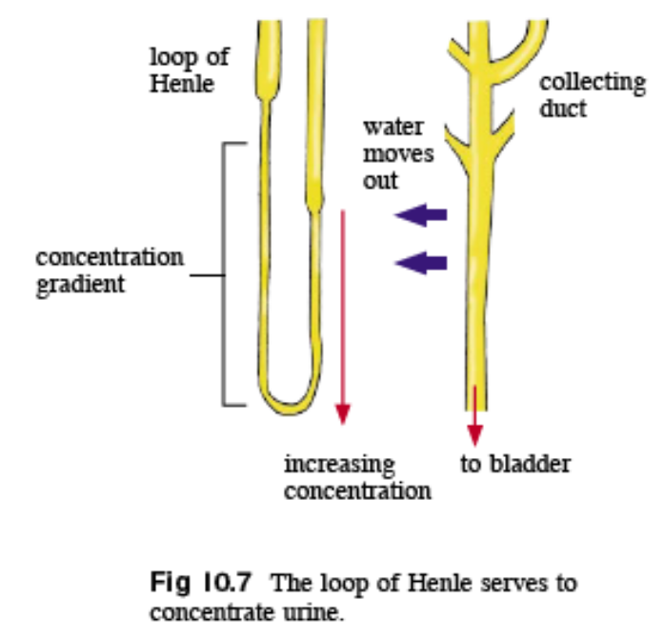
10.2 The Kidney

Slide 19
10.2 The Kidney
At the loop of Henle, the fluid is further concentrated by the transportation of salt out of the filtrate, setting up a greater concentration gradient at the base of the loop.
The fluid reaches the distal convoluted tubule, where excess substances such as hydrogen, potassium ions, and drugs are secreted.
The fluid flows through the collecting duct and passes the region where the concentration gradient was set up. The collecting duct reabsorbs water from the fluid and helps to regulate blood water concentration.

Slide 20
10.3 Osmoregulation
You should be able to:
Explain the role of the antidiuretic hormone (ADH) in osmoregulation; and
Outline the mechanism of dialysis in the case of kidney failure.

Slide 21
10.2 Osmoregulation
Homeostatic Control of Blood Water
Concentration – Osmoregulation
The pituitary gland secretes the antidiuretic hormone (ADH), which enables the kidney to regulate blood water concentration.
Changes in blood fluid levels is detected by the hypothalamus, which signals the pituitary gland to secrete more or less ADH.
ADH increases permeability of distal convoluted tubule and collecting duct to water.

Slide 22
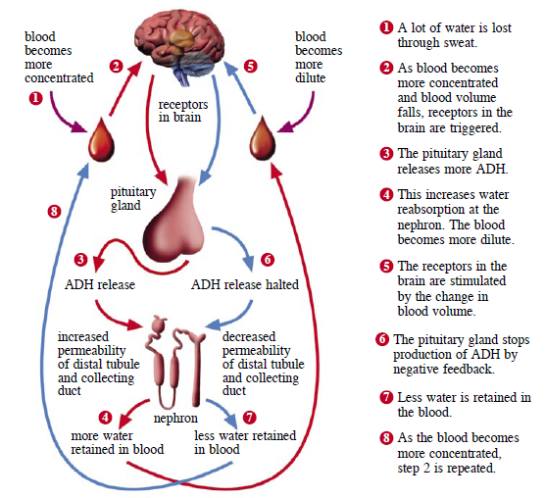
10.2 Osmoregulation

Slide 23
10.2 Osmoregulation
When Kidneys Fail
It can be due to high blood pressure and diabetes.
A person with kidney failure needs dialysis in order to remove wastes from the body and prevent toxins from accumulating.
Blood is drawn from a patient’s vein and pumped through a dialysis machine.
The dialysis tubing is partially permeable.
The dialysis fluid contains the same concentration of essential substances as the blood.
The direction of blood flow is opposite to the flow of dialysis fluid.

Slide 24
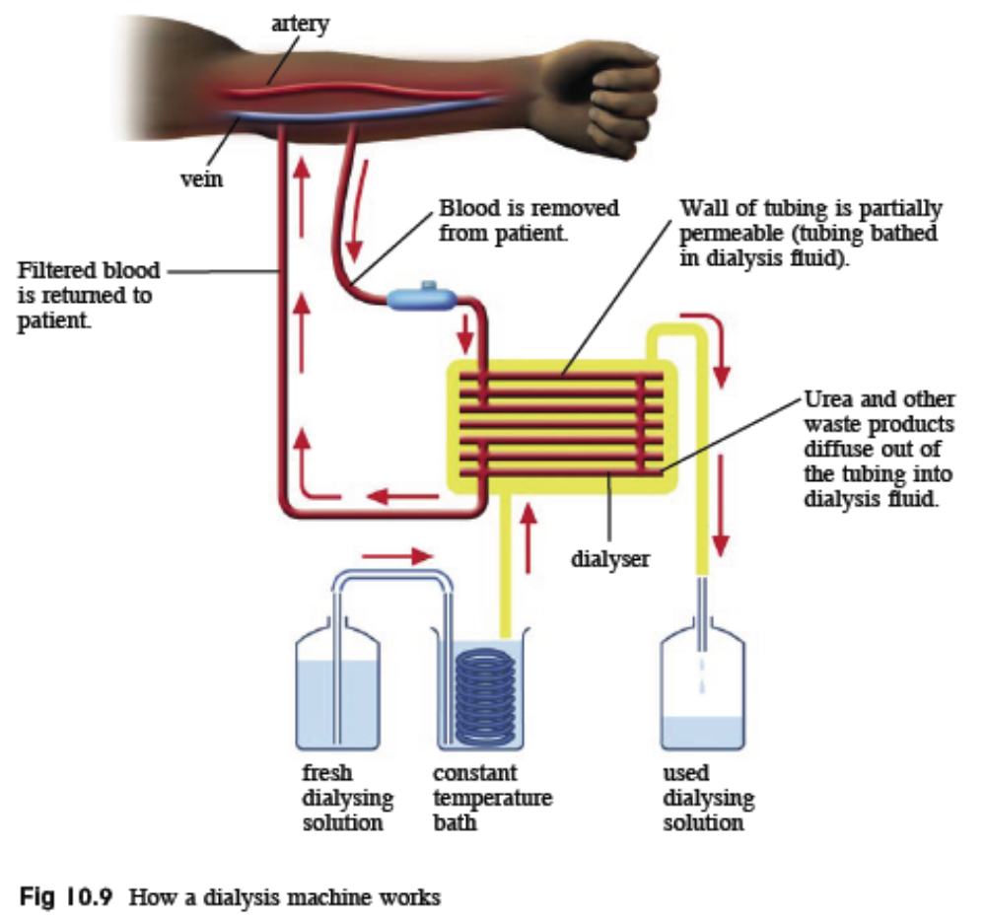
10.2 Osmoregulation

Slide 25
Key Concepts
Carbon dioxide, salts and nitrogenous waste are the main source of metabolic waste excreted by animals and humans.
The nephron is the basic functional unit of the kidney.
Urine formation involves ultrafiltration and selective reabsorption.
Useful materials in the blood are first filtered out along with the waste products, before being reabsorbed into the blood.
The kidney carries out osmoregulation using the antidiuretic hormone, as part of a negative feedback mechanism.
The amount of water reabsorbed at the distal tubules and the collecting duct depends on the amount of antidiuretic hormone secreted by the pituitary gland.

